Slide 1
Math for Simple ConvNet Example
Loosely corresponds to StackOverflow example: https://stackoverflow.com/questions/42786717/how-to-calculate-the-number-of-parameters-for-convolutional-neural-network
… except I decreased the kernels in the Conv2D layers so that I could show you what happens visually!
Later on, I’ll show you my handwritten math solution for the StackOverflow example.

Slide 2
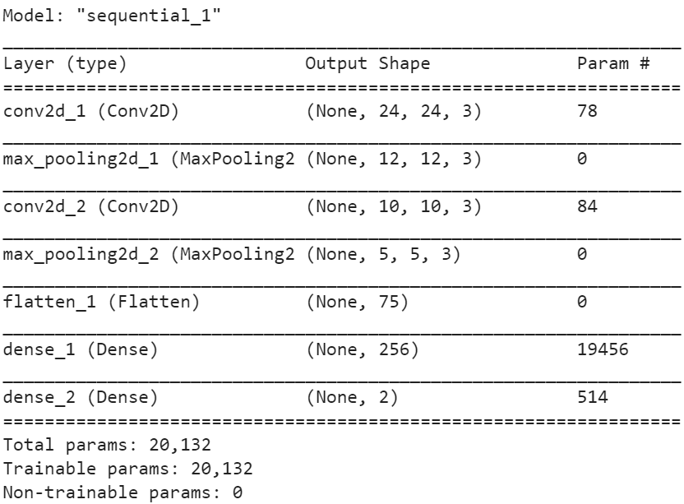
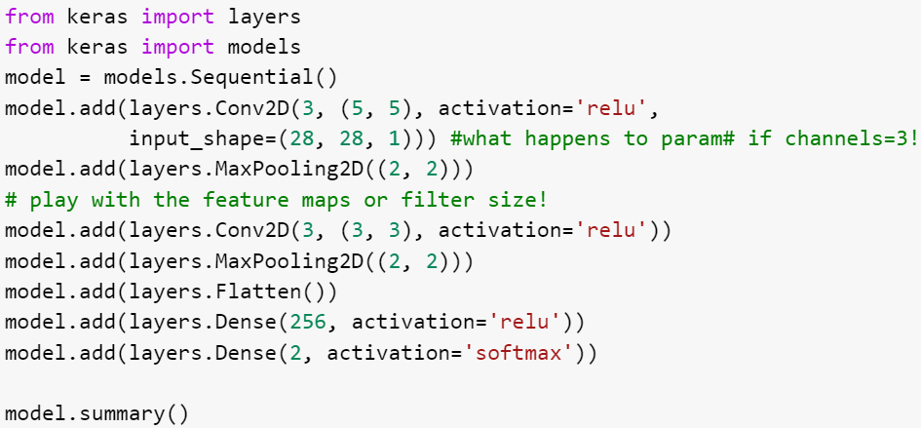
A simple ConvNet Example
Remember… we are just making different representations of data (feature maps) by using different kernels…
If I give you just the image on the left, can you do the math and get the image on the right?
If I gave you the code on the left, could you add meaningful comments and describe the arguments to the functions?
You should have mastery of what everything means on this slide!!!

Slide 3
Look at the number of trainable parms in this ConvNet… 20K!
Think about how many hidden units and layers you would need to get that close - your Module 2 MNIST dense network needed ~407,000 parameters for the same kind of job. 20x more!
Then remember how DNNs can’t handle rotated/augmented data… but that ConvNets can!

Slide 4
Size of the outputted feature maps
A reminder...
M, N are the filter size
Stride will always be 1 for our examples (not needed in formula)
L is the number of channels coming INTO this layer (input image: 1 BW / 3 RGB; deeper layers: the previous layer's F)
B is the bias, and it’s always 1
F is the number of feature maps that will be created
First you need the size of the rows and columns…
Size of rows and columns = (S_{o} – (m-1)) # this gives you rows and columns
This is true when there is no padding (which we will use in our class - always perfectly pick our kernel sizes so we don’t have any remainders).
The convention is:
(BATCH, ROWS, COLUMNS, CHANNELS)
BATCH is always “NONE” (you decide the batch when you fit the model!)
ROWS and COLUMNS are calculated above
The CHANNELS are the number of FEATURE MAPS that are created after convolution layers (given in the code).

Slide 5
Number of trainable parameters
A reminder...
M, N are the filter size
Stride will always be 1 for our examples (not needed in formula)
L is the number of channels coming INTO this layer (input image: 1 BW / 3 RGB; deeper layers: the previous layer's F)
B is the bias, and it’s always 1
F is the number of feature maps that will be created
For Conv2D layers, it’s…
# of trainable parms = ((M * N * L) +B) * F
From Flatten to Dense, or Hidden to Hidden, or Hidden to Output, it’s…
# of trainable parms = (INPUT COLUMNS + B)*HIDDEN UNITS IN OUTPUT LAYER

Slide 6
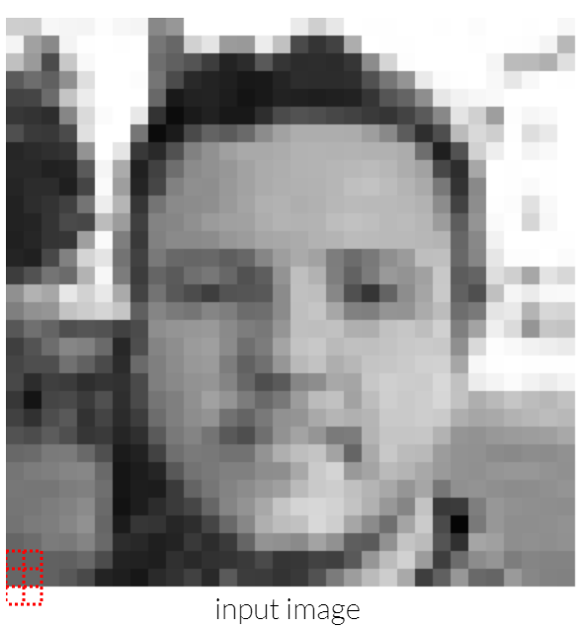
Start Here
Input image,
28 x 28,
1 channel (grayscale)

Slide 7
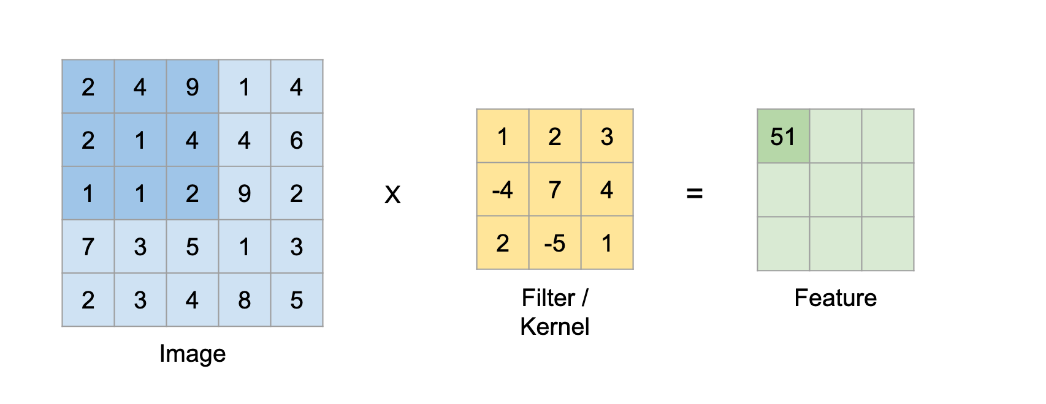
Convolution2D (light downsampling)

Slide 8
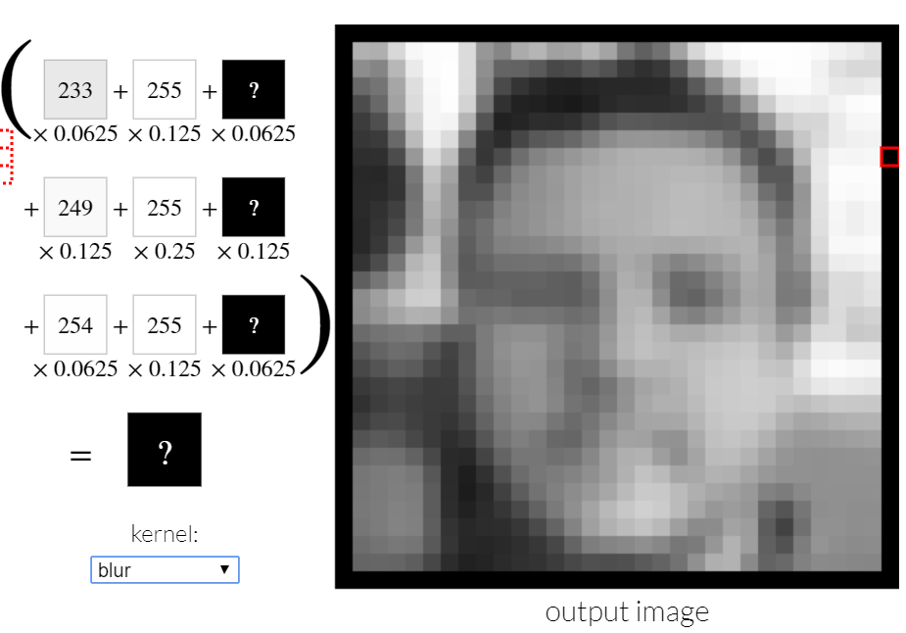
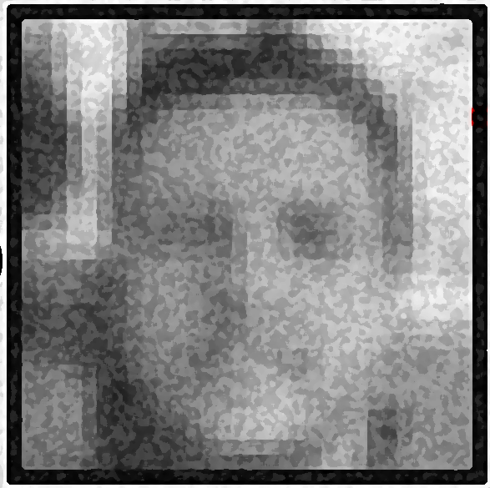

(NONE,24,24,3)
# of trainable parms = ((M * N * L) +B) * F
NOTES
After convolution, we get 3 different feature maps.
These were generated with a sliding 5x5 kernel going across the image.
Kernel weights are originally random, and updated via backpropagation.
Our nice 28x28 input image gets slimmed down to 24x24 (light down-sampling) thanks to conv2D
Pay attention to format of output size
(BATCH, ROW, COLS, CHANNELS)
In our example, BATCH is always NONE (this is decided later in the script).
CHANNELS ARE THE FEATURE MAPS. That’s why there’s a 3 in (NONE,24,24,3)… we generated 3 FEATURE MAPS.
BE CAREFUL AFTER THE SECOND ROUND OF CONV2D (later on)! This is what confuses most students.
Size of resultant feature map = (S_{o} – (m-1))
Don’t forget about batch size and the number of feature maps when writing the output shape!
(NONE,28,28,1)
Input image
M, N are the filter size
Stride will always be 1 for our examples (not needed in formula)
L is the number of channels coming INTO this layer (input image: 1 BW / 3 RGB; deeper layers: the previous layer's F)
B is the bias, and it’s always 1
F is the number of feature maps that will be created
Convolution2D,
3 different feature maps,
Stride of 1,
Kernel Size = (5,5).
PARM=78

Slide 9
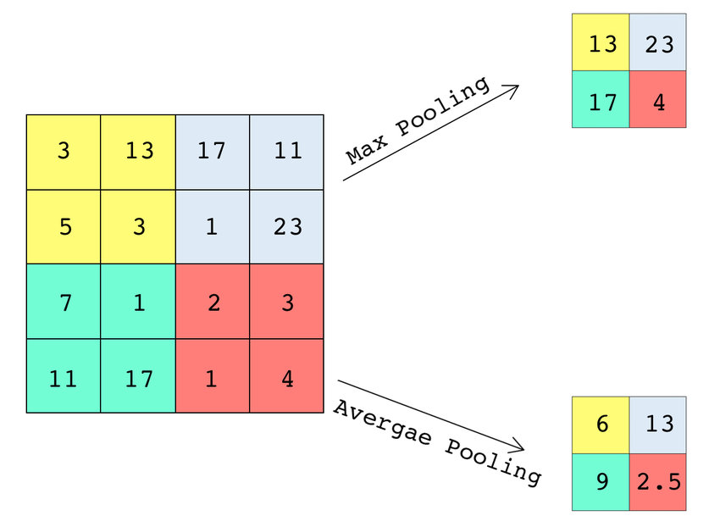
MaxPooling2D (aggressive downsampling)
Max or average? Your choice! Most people just use MaxPooling and move on...

Slide 10
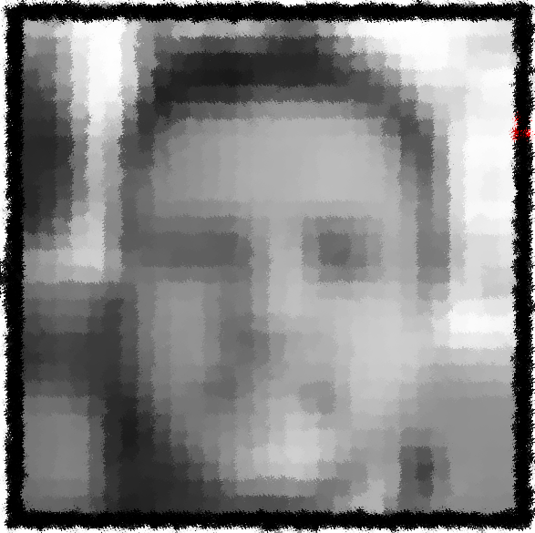
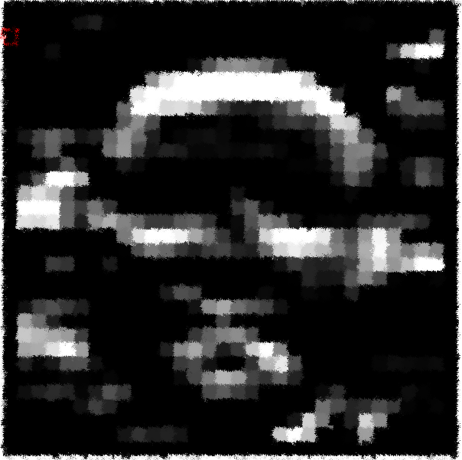
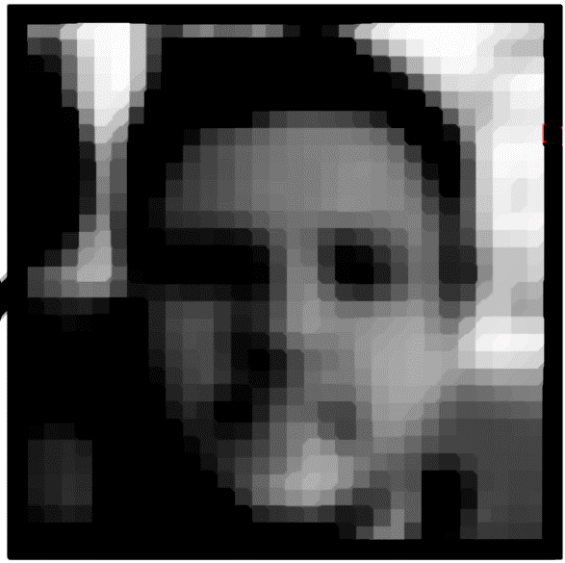
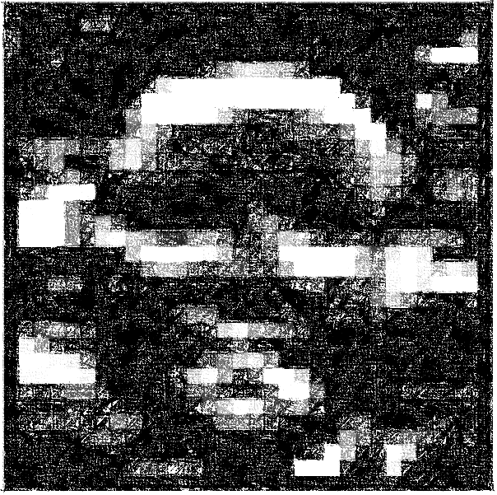
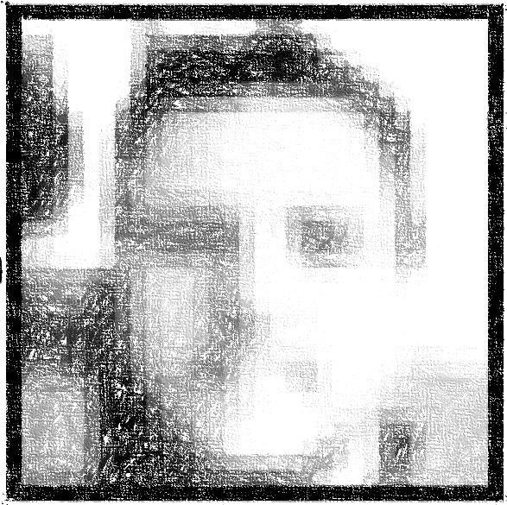
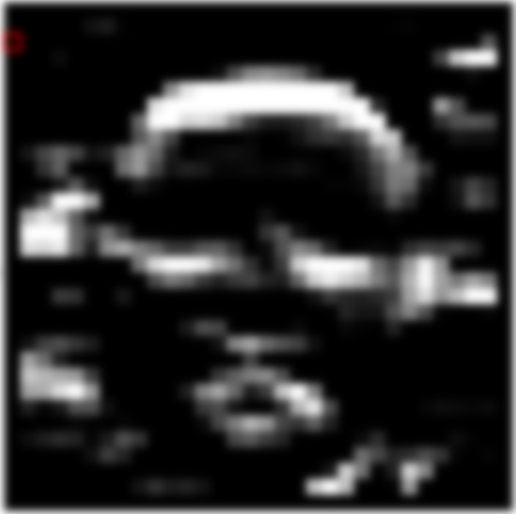
(NONE,24,24,3)
# of trainable parms = ((M * N * L) +B) * F
(NONE,12,12,3)
Size of resultant feature map = (S_{o} – (m-1))
Don’t forget about batch size and the number of feature maps when writing the output shape!
(NONE,28,28,1)
NOTE:
Because we used a 2x2 kernel for MaxPooling, our resultant feature maps got halved! From 24x24 to 12x12!
This will always be true for a 2x2 kernel… but make sure you use the formula, because I like to throw 3x3 and 5x5 pooling layers at you for giant input images…
NO trainable parameters for Pooling Layers… it’s naïve… just a bunch of max values…
Input image
Convolution2D,
3 different feature maps,
Stride of 1,
Kernel Size = (5,5)
MaxPooling2D,
Same 3 feature maps as input (just dimension reduction). Each of the previous maps gets pooled.
PARM=78
PARM=0

Slide 11
Convolution2D (light downsampling)

Slide 12
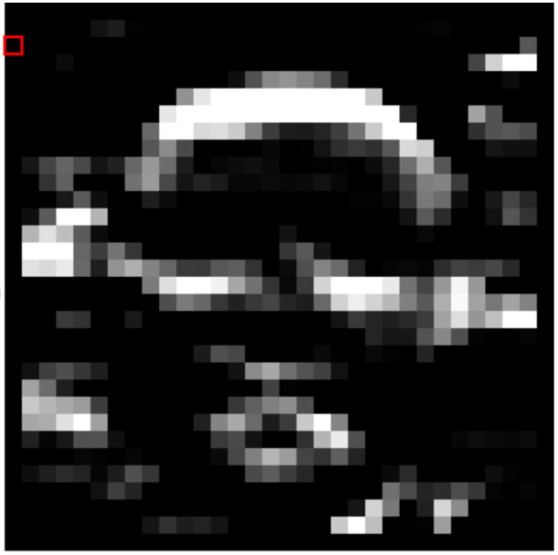
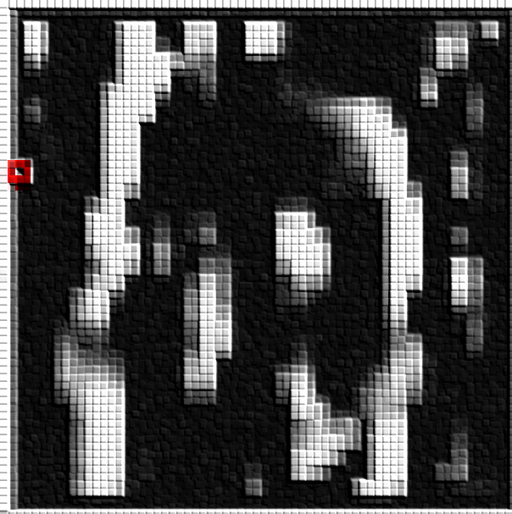
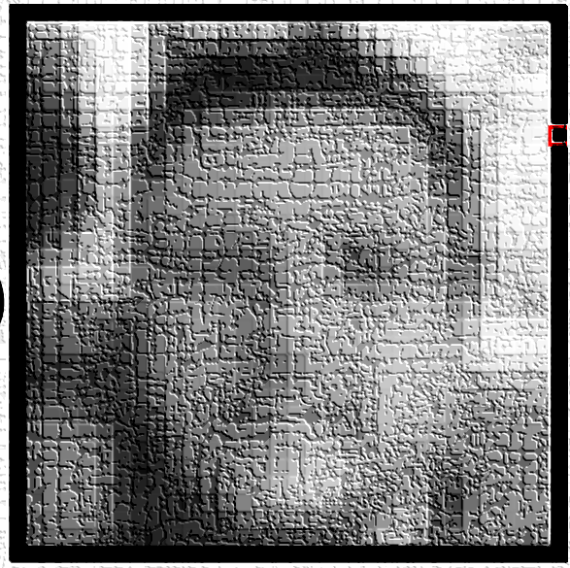
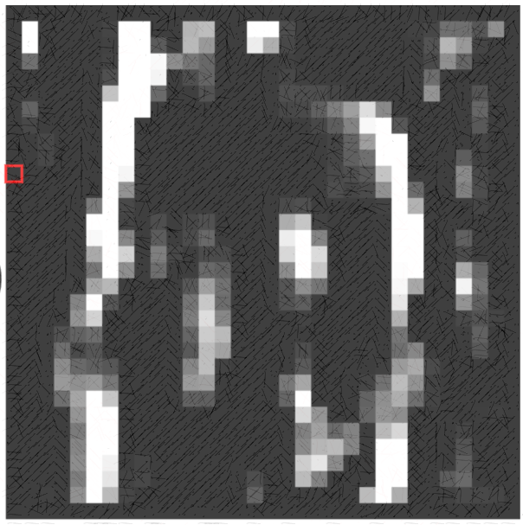
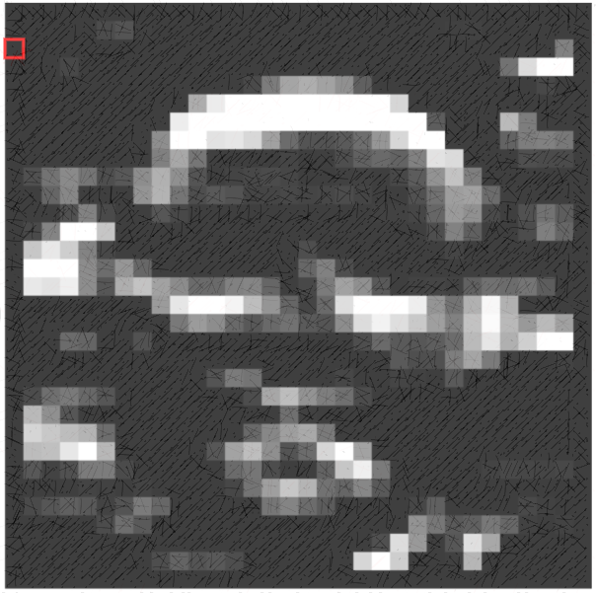
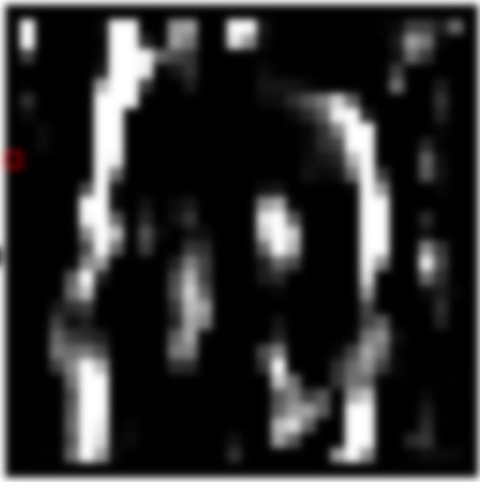
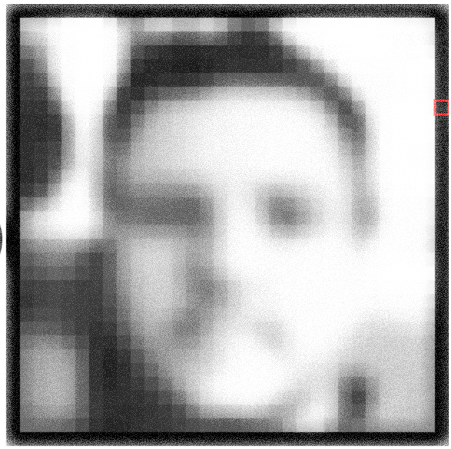
(NONE,24,24,3)
(NONE,12,12,3)
(NONE,10,10,3)
(NONE,28,28,1)
NOTES
THEN FOR ONE POOLED FEATURE MAP…
(implied because our batch size is always NONE).
3 features were generated for EACH POOLED FEATURE MAP…
You may be tempted to consider all of the feature maps from the pooled layer…
BUT DON’T DO IT! This is the hardest part of the exam… keeping track of the batch size.
Input image,
1 channel,
28 x 28 pixels
Convolution2D,
3 feature maps are created,
Stride of 1,
Size = (5,5). Lose two rows and two cols on each side.
MaxPooling2D,
same feature maps as input (just dimension reduction). Each of those maps gets pooled.
Convolution2D. Each feature map from the pooling layer undergoes convolution again.
PARM=78
PARM=0
PARM=84

Slide 13
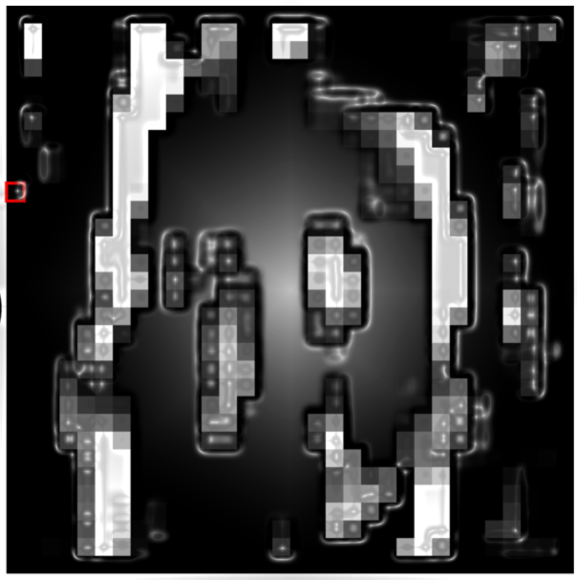
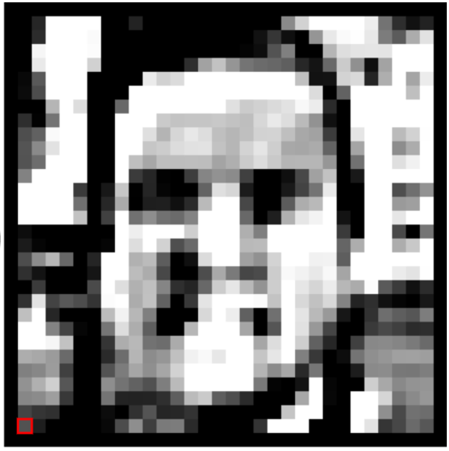

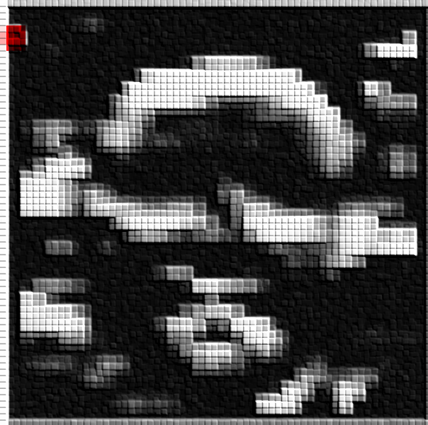
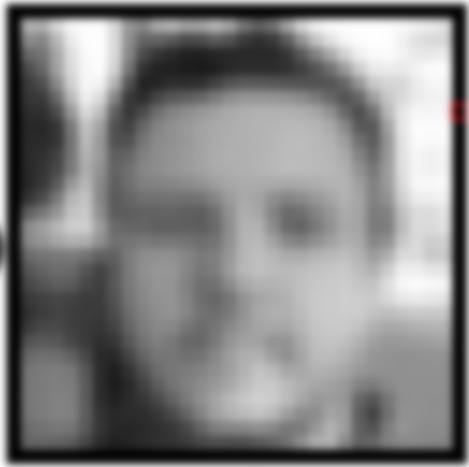
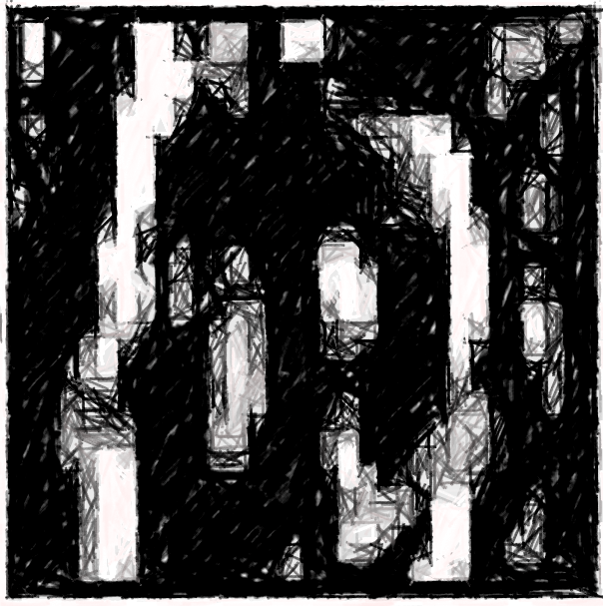
(NONE,24,24,3)
(NONE,12,12,3)
(NONE,10,10,3)
NOTE:
Remember – pooling is aggressive down-sampling… use the formula to see how size changes…
When you have a 2x2 window in maxPooling, you will HALVE the size of your feature map!
No trainable parms for pooling… it’s naïve…
(NONE,5,5,3)
(NONE,28,28,1)
Input image,
1 channel,
28 x 28 pixels
3 feature maps…
Convolution2D,
3 feature maps are created,
Stride of 1,
Size = (3,3). Lose a row and col on each side.
MaxPooling2D,
same feature maps as input (just dimension reduction). Each of those maps gets pooled.
Convolution2D. Each feature map from the pooling layer undergoes convolution again.
MaxPooling2D, same feature maps as input (just dimension reduction). Each of those maps gets pooled.
PARM=78
PARM=0
PARM=84
PARM=0

Slide 14
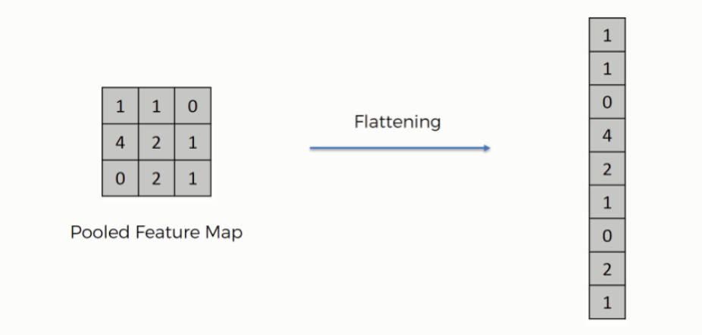

Slide 15
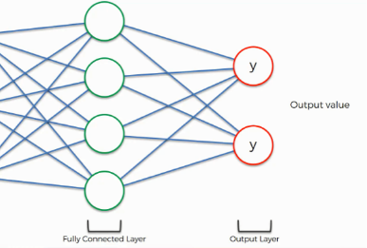
(NONE,24,24,3)
(NONE,12,12,3)
5x5x3=(NONE,75)
(NONE,10,10,3)
(NONE,5,5,3)
(NONE,28,28,1)
(NONE, 256)
(NONE,2)
Output
params = (256+1)*2
Or…
= 514 params
Input image,
1 channel,
28 x 28 pixels
Dense layer
3 feature maps…
params = (75+1)*256
Or…
= 19,456 params
Convolution2D. Each feature map from the pooling layer undergoes convolution again. Lose a row and column on each side.
Convolution2D,
3 feature maps are created,
Stride of 1,
Size = (5,5). Lose two rows and two columns on each side.
MaxPooling2D,
same feature maps as input (just dimension reduction). Each of those maps gets pooled.
MaxPooling2D, same feature maps as input (just dimension reduction). Each of those maps gets pooled.
Flatten, now it’s like the input to a DNN
REMEMBER…
Different formulas for dense layers vs. Conv2D
PARM=78
PARM=0
PARM=84
PARM=0
PARM=0

Slide 16
Comparison of different kernels
Our kernels will be learned from the data for our specific process, but here are some cool looking ones from Photoshop.
http://setosa.io/ev/image-kernels/

Slide 18
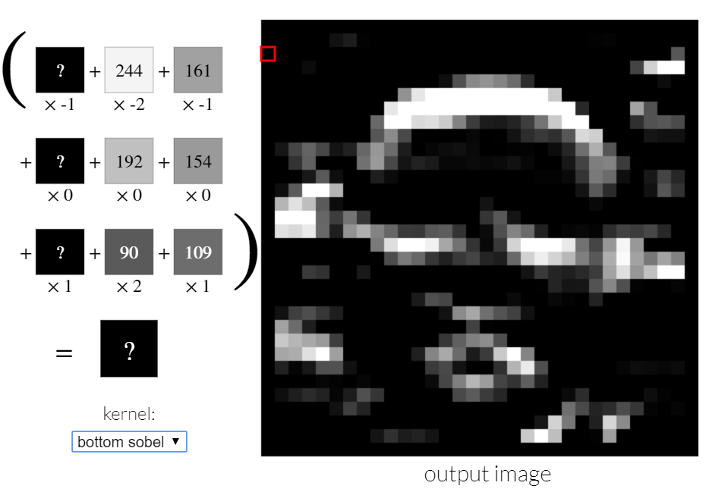

Slide 19
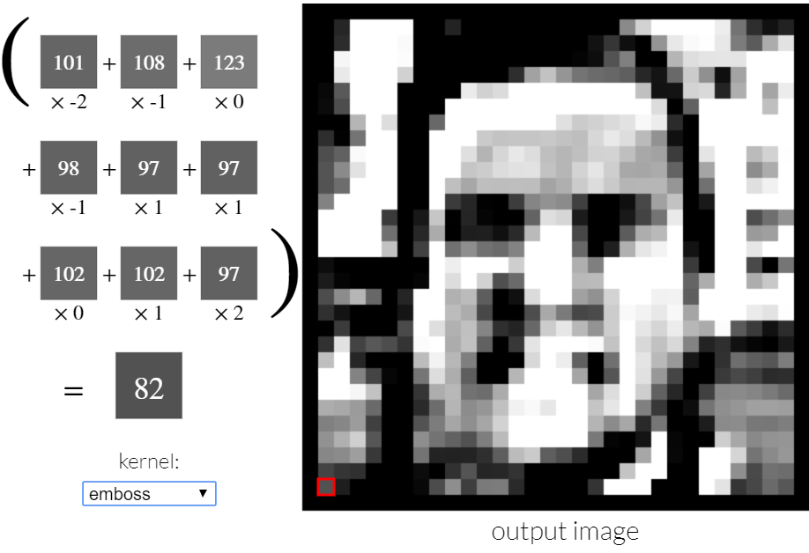

Slide 20
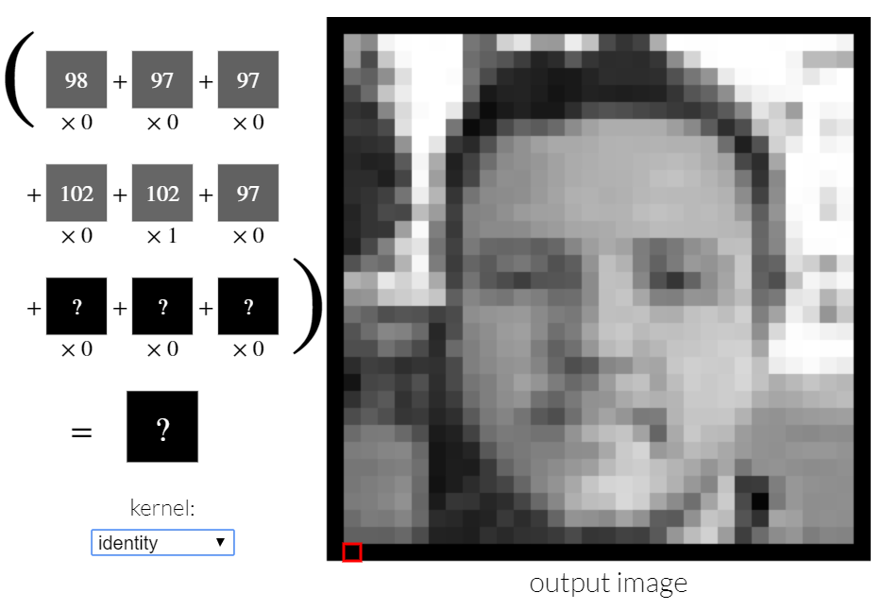

Slide 21
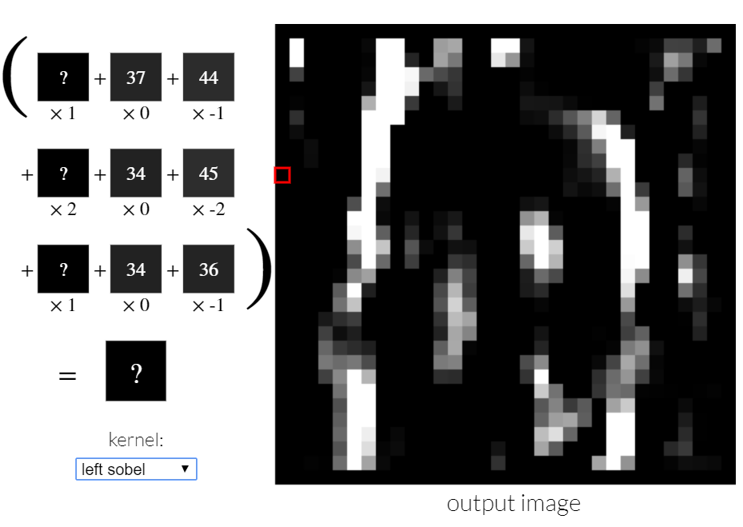

Slide 22
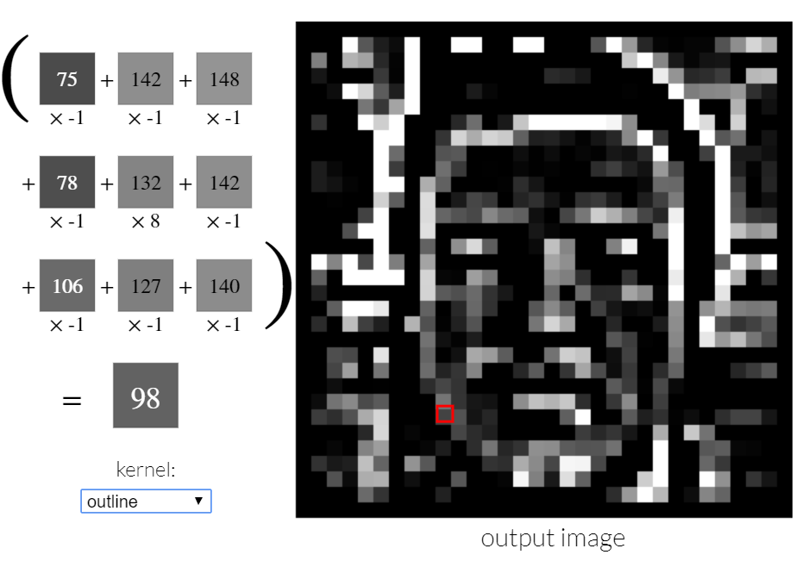

Slide 23
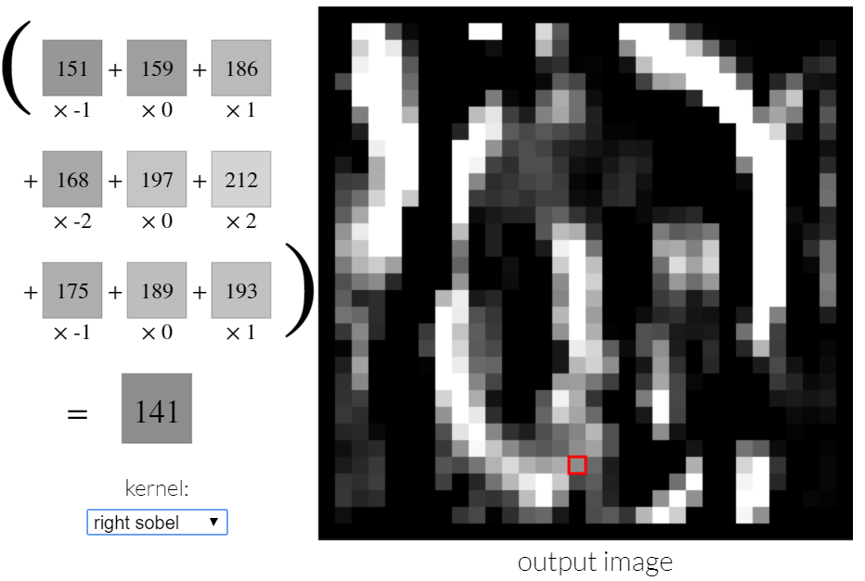

Slide 24
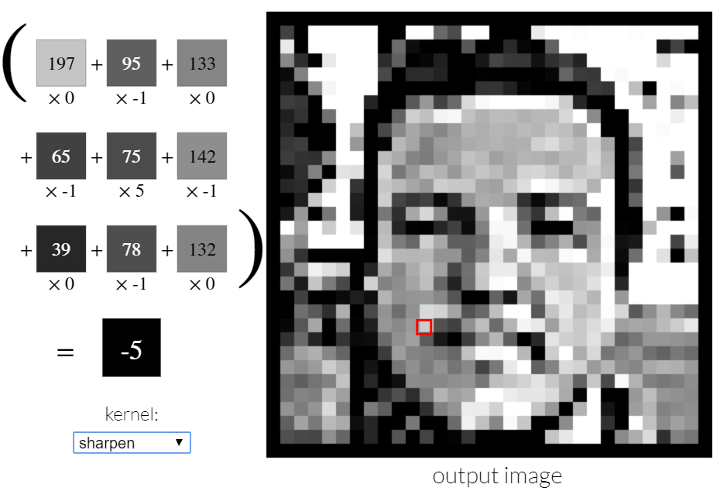

Slide 25
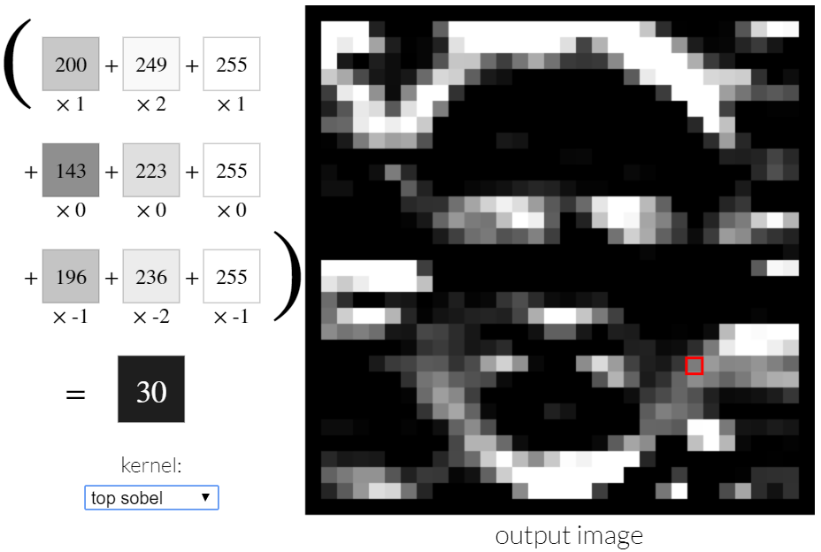

Slide 26
APPENDIX: Some good links

Slide 27
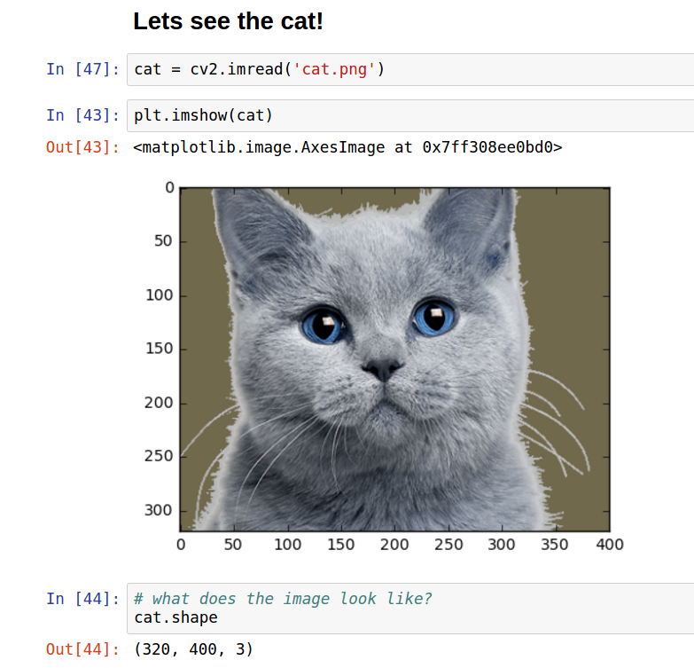
Excellent Intro Blog
“Visualizing parts of Convolutional Neural Networks using Keras and Cats”
https://hackernoon.com/visualizing-parts-of-convolutional-neural-networks-using-keras-and-cats-5cc01b214e59

Slide 28
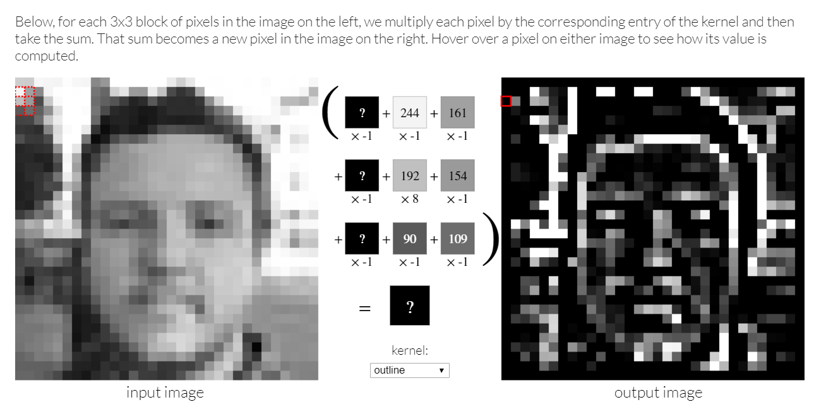
Convolution example
Play with different kernels! Kind of like Photoshop… this is what our convolutional layers are doing.
http://setosa.io/ev/image-kernels/

Slide 29
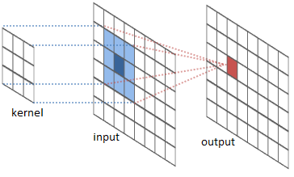
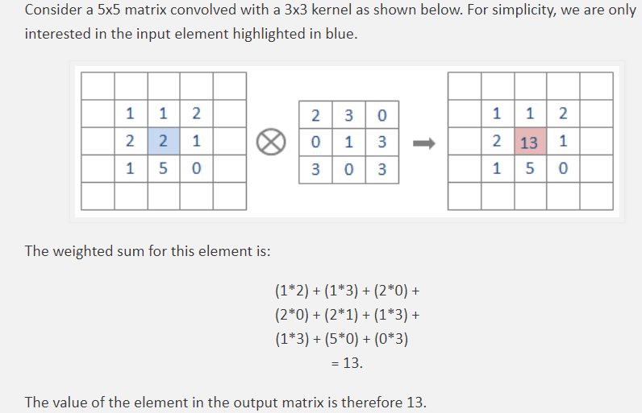
Another Good Convolution Example
https://ricardodeazambuja.com/deep_learning/2017/03/05/easy-peasy_conv_deep_learning_two/
Whole blog post is good! Check out the video for a real-time example.

Slide 30
One more
http://cs231n.github.io/convolutional-networks/

Slide 31
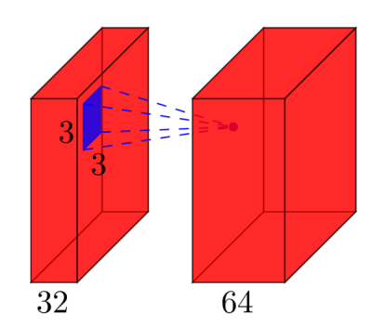
Stackoverflow example
https://stackoverflow.com/questions/42786717/how-to-calculate-the-number-of-parameters-for-convolutional-neural-network

